Slide 1
Relationships and Sex Education (RSE) Consultation

Slide 2
What is RSHE?
The Department for Education has introduced compulsory RSHE from September 2020 for all primary schools. Due to the impact of Covid-19 this has been pushed back to no later than the start of the summer term 2021.
The aim of RSHE is to give young people the information they need to help them develop healthy, nurturing relationships of all kinds, not just intimate relationships. It should enable them to know what a healthy relationship looks like and what makes a good friend, a good colleague and a successful marriage or other type of committed relationship.
It should teach what is acceptable and unacceptable behaviours in relationships.
Pupils will understand the positive effects that good relationships have on their mental wellbeing, identify when relationships are not right and understand how such situations can be managed.
The Department for Education recommends that all primary schools have a sex education programme tailored to the age and the physical and emotional maturity of the pupils. It should ensure that both boys and girls are prepared for the changes that adolescence brings and – drawing on knowledge of the human life cycle set out in the national curriculum for science – how a baby is conceived and born.

Slide 3
Why is Relationships, Sex and Health (RSHE) Education in Schools Important?
High quality RSE helps create safe school communities in which students can grow, learn, and develop positive, healthy behaviour for life, and for the following reasons:
Schools maintain a statutory obligation under the Children Act (2004) to promote their students’ wellbeing and under the Education Act (2002) to prepare children and young people for the challenges, opportunities and responsibilities of adult life. A comprehensive RSHE programme can have a positive impact on students’ health and wellbeing and their ability to achieve, and can play a crucial part in meeting these obligations.
Technology is evolving at a tremendous pace. The need to protect children and young people from inappropriate online content, cyberbullying and exploitation is a growing concern. A comprehensive RSE programme can support in addressing these issues.
We would want all pupils to grow with the knowledge of natural changes before they happen, and pupils can encounter puberty at a relatively young age. For example, while the average age for a girl to begin menstruation in the UK is 12, many begin in Y6 and some in Y5.
Safeguarding children is at the heart of Relationships, Sex and Health Education.

Slide 4
What are the benefits of teaching RSE?
RSE explains the positive qualities of relationships, such as trust, respect and commitment as well as recognising that there are different types of relationships and families.
It raises the importance of educating children about gender equality, consent, relationships and sex in an age appropriate way.
RSE can provide young people with the knowledge required to resist peer, partner and media pressure and understand issues of consent as well as what is and is not appropriate behaviour.
Teaching at school will complement (NOT REPLACE) and reinforce the lessons families teach their children as they grow up.

Slide 5
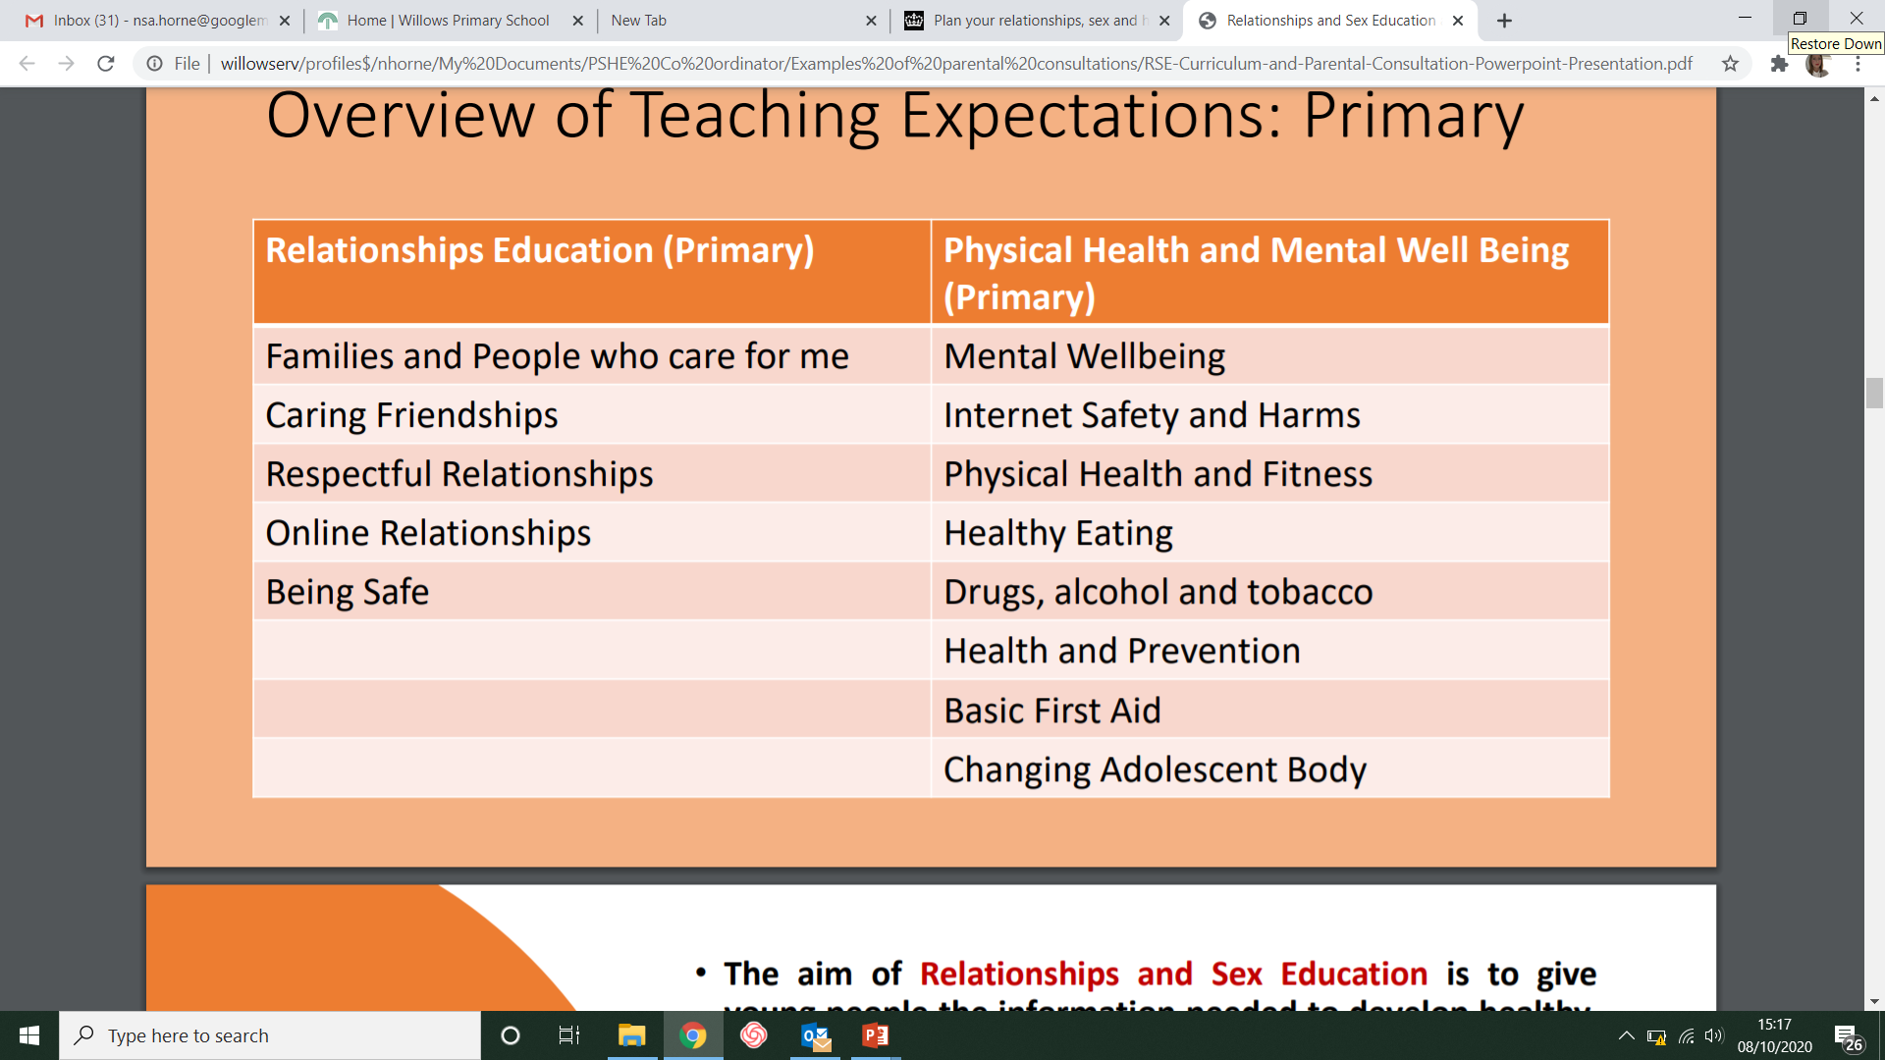
Overview of Teaching Expectations
Sex education is not compulsory in primary schools. Teaching sex education is tailored to take account of the age and the physical maturity of the pupils and allows parents to withdraw their children where requested.

Slide 6
How will we be teaching RSHE?
We follow the Jigsaw PSHE scheme of learning, the Kent science curriculum and the RSHE program by the Christopher Winters Project .
The Christopher Winter Project has content organised by year group, from YR – Y6. A comprehensive programme gives children and young people essential skills for building positive, enjoyable, respectful and non-exploitative relationships and staying safe both on and offline. This is based on three lessons for each year group which will be taught in the Summer 2 term. It is designed to support and enhance the units covered by the PSHE scheme.

Slide 7
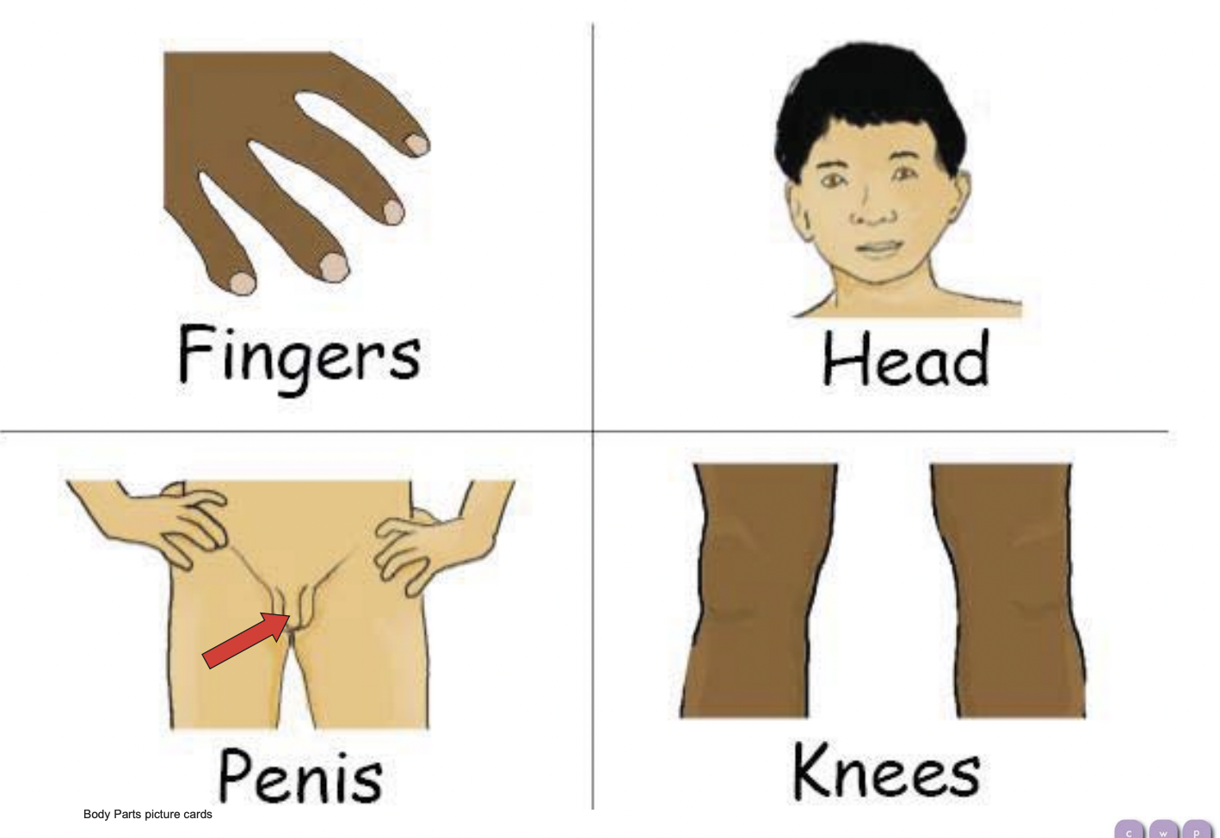
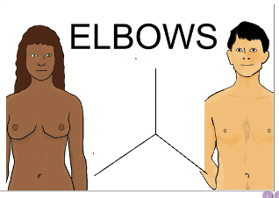
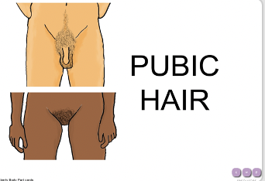
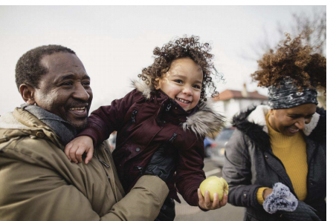
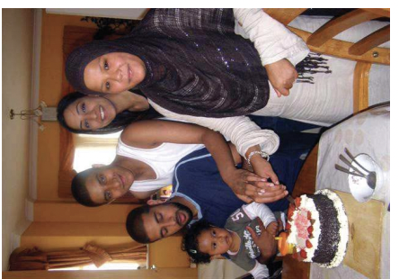
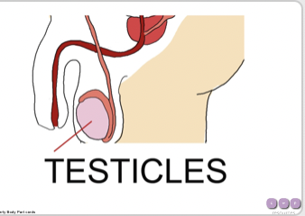
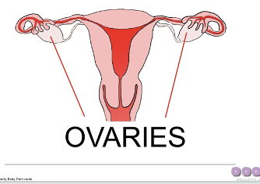
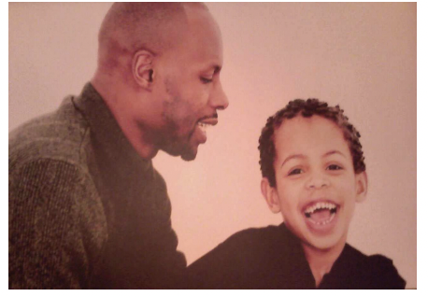
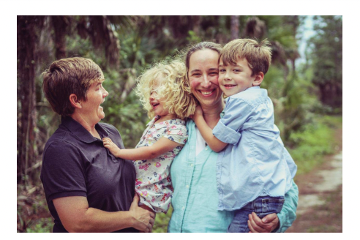
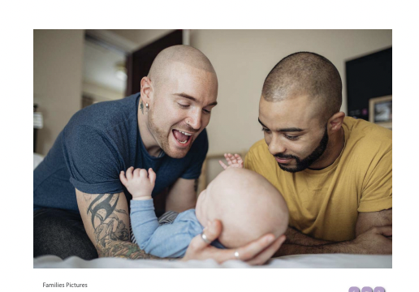
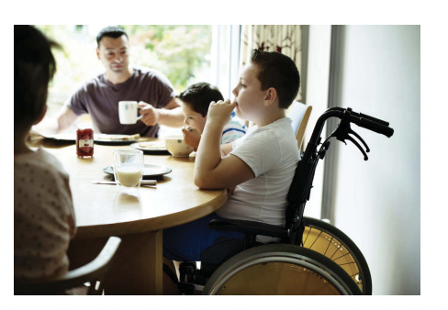
Examples of lessons and images shared
Year 2
Year 6

Slide 8
Lessons taught through Christopher Winter Project (RSHE)
YEAR | TOPIC | LESSON DETAILS
EYFS | Family and Friendship | Lesson 1 Caring friendships- recognising the importance of friendship Lesson 2 Being kind- recognise the importance of saying sorry and forgiveness Lesson 3 Families- all families are different
1 | Growing and Caring for Ourselves | Lesson 1 Different friends- we are all different but still friends Lesson 2 Growing and Changing- how do we grow and change (life cycles) Lesson 3 Families and Care- explore different types of family and who cares for us
2 | Differences | Lesson 1 Differences- differences between males and females/ gender stereotypes Lesson 2 Male and Female Animals- male and female animals and lifecycles Lesson 3 Naming body parts- describe physical differences between boys and girls and name parts
3 | Difference and Keeping Safe | Lesson 1 Body differences- people are unique and respect differences Lesson 2 Personal space- appropriate and inappropriate contact Lesson 3 Help and support- explore different types of family and who to go to for support
4 | Growing up | Lesson 1 Changes- human lifecycle Lesson 2 What is puberty- physical and emotional changes Lesson 3 Healthy relationships- respect in relationships
5 | Puberty | Lesson 1 Talking about puberty- emotional and physical changes in puberty Lesson 2 The reproduction system- changes in more detail Lesson 3 Puberty help and support- physical hygiene/ ways to get support
6 | Puberty, relationships and reproduction | Lesson 1 Puberty and reproduction Lesson 2 communication in relationships- importance of communication and respect Lesson 3 Families, conception and pregnancy- ways people might start a family Lesson 4 Online relationships- positive and negative communication

Slide 9
Which other subjects does it relate to in the national curriculum?
Science
In KS1 - Pupils are taught to notice that animals, including humans, have offspring which grow into adults. They are also introduced to the processes of reproduction and growth in animals. The focus at this stage should be on questions that help pupils to recognise growth; they should not be expected to understand how reproduction occurs. The following examples might be used: egg, chick, chicken; egg, caterpillar, pupa, butterfly; spawn, tadpole, frog. Growing into adults can include reference to baby, toddler, child, teenager, adult.
In Upper KS2 (Y5/6) - Pupils are taught to describe the differences in the life cycles of a mammal, an amphibian, an insect and a bird and describe the life process of reproduction in some plants and animals. Pupils find out about different types of reproduction, including sexual and asexual reproduction in plants, and sexual reproduction in animals. They observe changes in an animal over a period of time (for example, by hatching and rearing chicks), comparing how different animals reproduce and grow.
Pupils are taught to describe the changes as humans develop to old age. Pupils draw a timeline to indicate stages in the growth and development of humans. They learn about the changes experienced in puberty including the names of body parts.

Slide 10
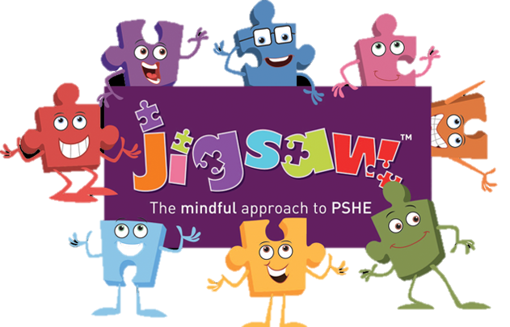
What is included in the ‘Changing Me’ unit?
Jigsaw’s ‘Changing Me’ unit is taught over a period of 3 weeks, usually in the second half of the summer term. Each year group will be taught appropriate to their age and developmental stage, building on the previous years’ learning.
At no point will a child be taught something that is inappropriate; and if a question from a child arises and the teacher feels it would be inappropriate to answer, (for example, because of its mature or explicit nature), the child will be encouraged to ask his/her parents or carers at home. The question will not be answered to the child or class if it is outside the remit of that year group’s programme.

Slide 11
Lessons taught through Jigsaw (PSHE)
YEAR | The Changing Me Puzzle is all about coping positively with change and includes:
EYFS | Lesson 1 Healthy foods Lesson 2 How to cope with changes/moving into Year 1 Lesson 3 Favourite things/ memories from Early Years
1 | Lesson 1 Growing and Changing- how do we grow and change Lesson 2 Understand that learning something new help me to change Lesson 3 How to cope with changes/moving into Year 2
2 | Lesson 1 Recognising the continuum of changed Lesson 2 Personal space- appropriate and inappropriate contact Lesson 3 Looking forward to Year 3
3 | Lesson 1 Understand that changes happens as animals and humans grow Lesson 2 Stereotypical ideas about parenting and family roles Lesson 3 Looking forward to Year 4
4 | Lesson 1 Confidence to try to make change Lesson 2 Fears and concerns about changes and know how to manage these Lesson 3 Looking forward to Year 5
5 | Lesson 1 Self-image Lesson 2 Becoming a teenager and understand this brings growing responsibilities. Lesson 3 Looking forward to Year 6
6 | Lesson 1 Self-esteem Lesson 2 Preparing for transition to secondary school

Slide 12
Can parents withdraw their child?
Parents have a right to withdraw their children from all or any part of Sex Education aspect of RSHE if they wish to do so, but not from the biological aspects of human growth and reproduction provided under the National Curriculum for science.
Requests for withdrawal should be put in writing, making it clear which aspects of the programme they do not wish their child to participate in.
There is no right to withdraw from Relationships Education or Health Education at Primary as the contents of these subjects- such as family, friendships, safety (including online safety) – are important for all children to be taught.

Slide 13
Which lessons can parents withdraw their children from?
Puberty is taught as a statutory requirement of Health Education and covered by our RSHE Programme Christopher Winter Project.
We conclude that sex education refers to Human Reproduction, and therefore parents can request their child be withdrawn from the PSHE lessons that explicitly teach this e.g.
Year 5, Lesson 2 (Puberty affects the reproductive organs)
Year 6, Lesson 1 (Puberty and reproduction)
Year 6, FGM lesson
Alternative work will be given to pupils who are withdrawn from non-statutory components of Sex Education.
Examples of the content of these lessons can be made available to parents if they wish.

Slide 14
Does the new RSHE curriculum take account of my faith?
The DfE states that Relationships Education has been designed to help children from all backgrounds build positive and safe relationships, and to thrive in modern Britain – this means taking into account the religious background of pupils when planning teaching, so that topics are appropriately handled.
In developing these subjects, the government has worked with a number of representative bodies and faith organisations, representing all the major faith groups in England.
The subjects are designed to help children from all backgrounds build positive and safe relationships, and to thrive in modern Britain.

Slide 15
Why are LBGT issues included?
There has been much mis-information in the media about how LGBT+ issues are to be taught within the Relationships, Health and Sex Education curriculum in primary schools. We believe that all pupils should be taught about the society in which they are growing up. Relationships Education is designed to foster respect for others and for difference and educate pupils about healthy relationships. We also believe that children should receive teaching on LGBT content during their school years. Teaching children about the society that we live in and the different types of loving, healthy relationships that exist is very important.
The DFE have stated:
“Pupils should be able to understand the world in which they are growing up, which means understanding that some people are LGBT, that this should be respected in British society, and that the law affords them and their relationships recognition and protections”
Sexual orientation is a protected characteristic, as defined by the Equality Act 2010, and therefore it is illegal to show prejudices against anyone for it.
Throughout our school we show respect for others and celebrating our differences.

Slide 16
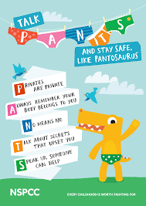



Additional resources to support conversations at home
Talking about relationships
Talking about puberty
Talking about sexuality
PANTS – discussing private parts
with your child

