Slide 1
Secondary School Transfer
Application opens: 1 September 2025 via the eAdmissions portal.
Deadline: 31 October 2025
https://services.southwark.gov.uk/schools-and-education/school-admissions/secondary-admissions/applying-for-a-secondary-school-place
School offers released: 1 March 2026 for on-time applicants.

Slide 2
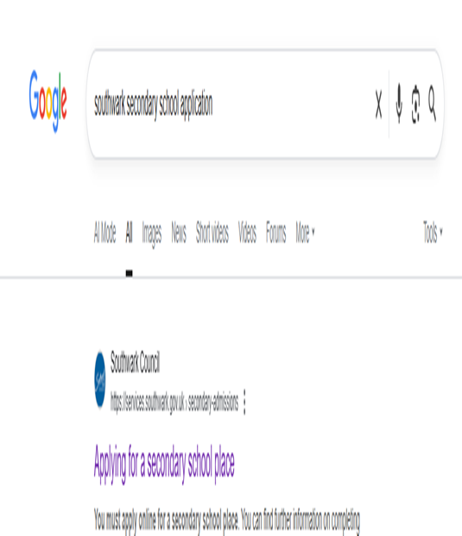

Slide 3
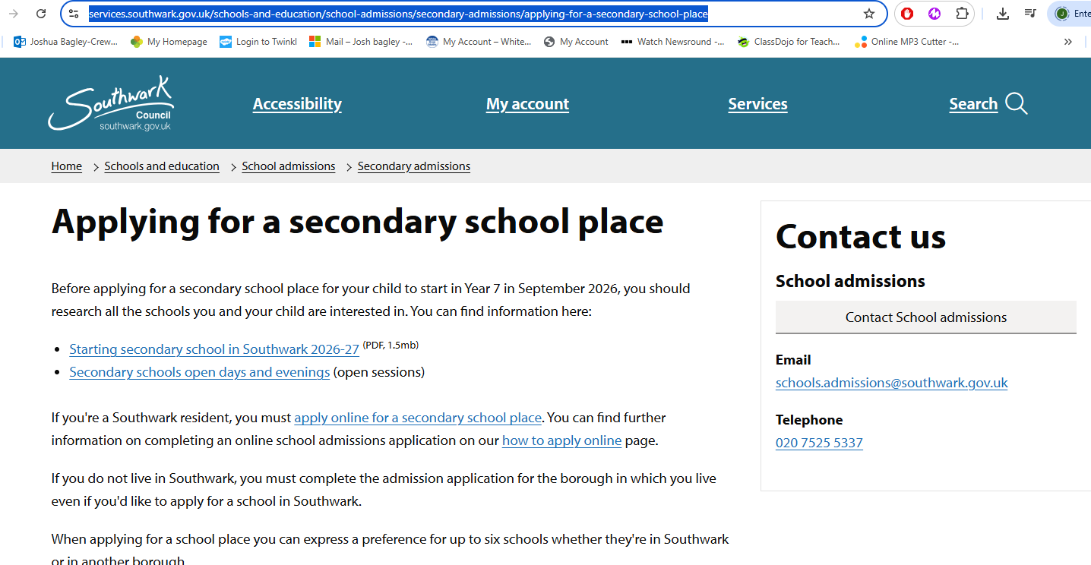

Slide 4
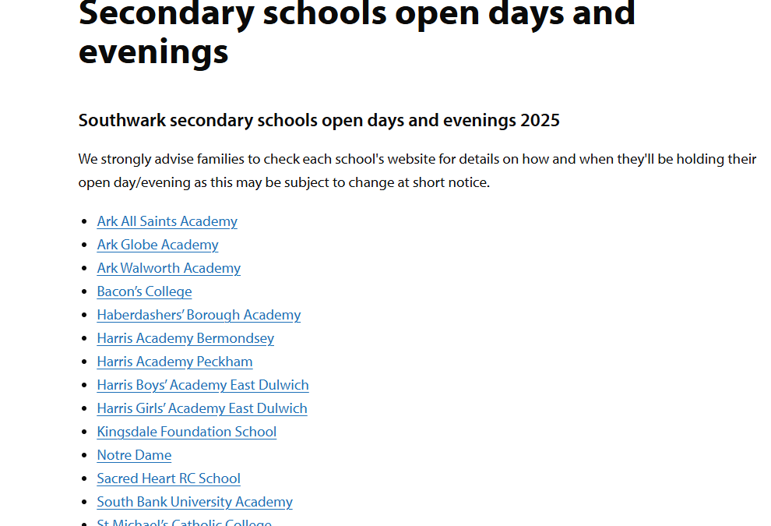

Slide 5
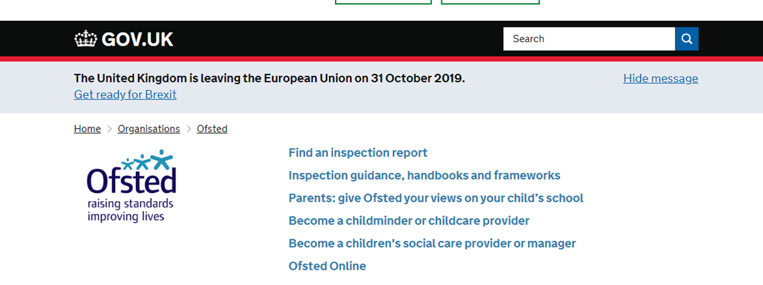
Finding the right school
Visit as many schools as you can
(check the school’s website for how and when they will be holding their open days)
Look at websites and brochures
Read the most recent OFSTED reports www.gov.uk/government/organisations/ofsted

Slide 6
School preferences
You are given the opportunity to express up to 6 preferences for your child’s school placement.
Make sure that your child meets the schools entrance requirements.
Your child may not get your first choice so make sure you do include other preferences.
You can select 6 schools whether they are in Southwark or within a different borough.

Slide 7
How to apply
You will need an email address
You will need to set up an account on eadmissions

Slide 8
How to apply
APPLY ONLINE
If you don’t live in Southwark, complete the admission application form for the borough in which you live. E.g. Lambeth.
Go onto the eadmissions website. ( You will need to create an account)
https://www.eadmissions.org.uk/user/home/

Slide 9
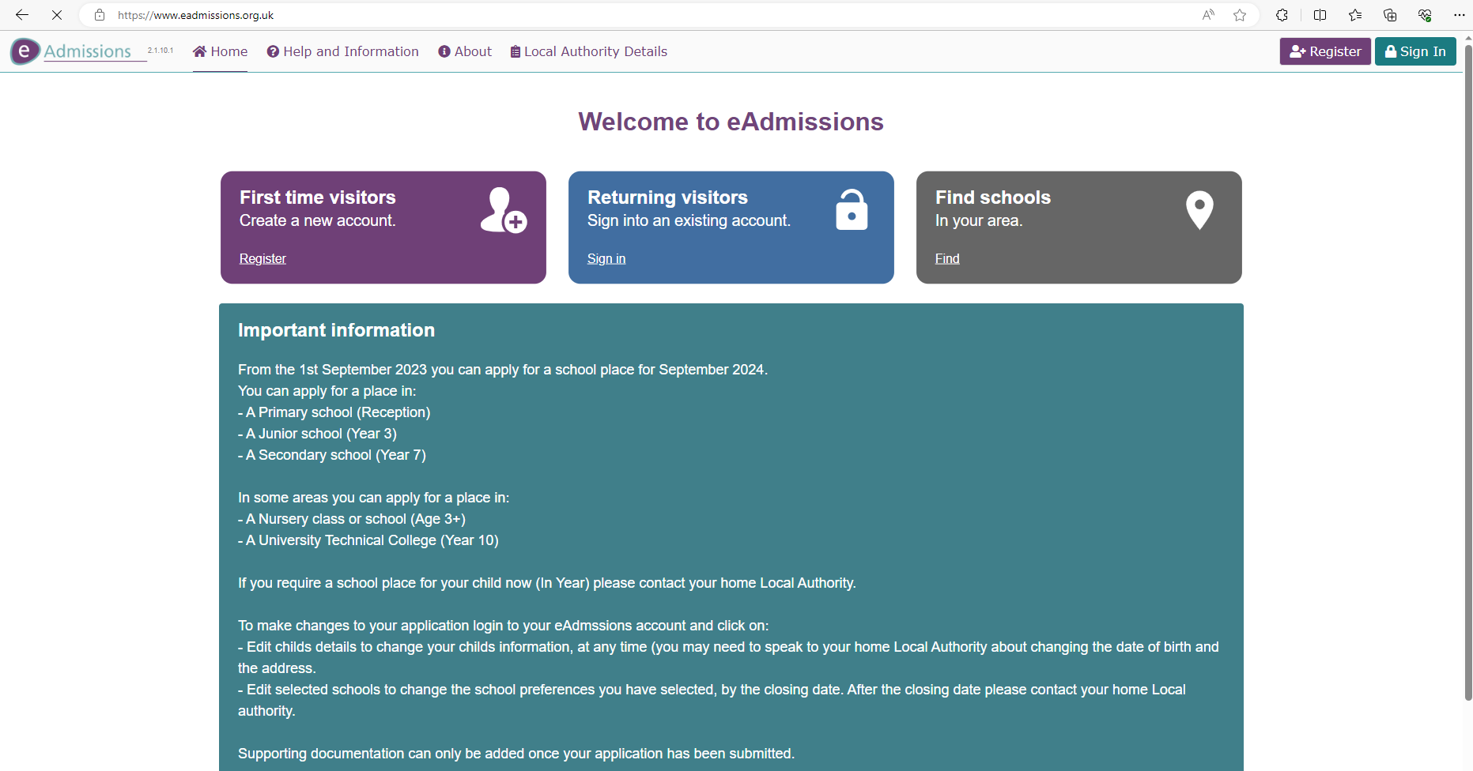

Slide 10
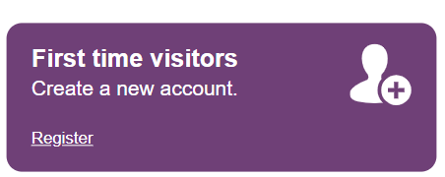
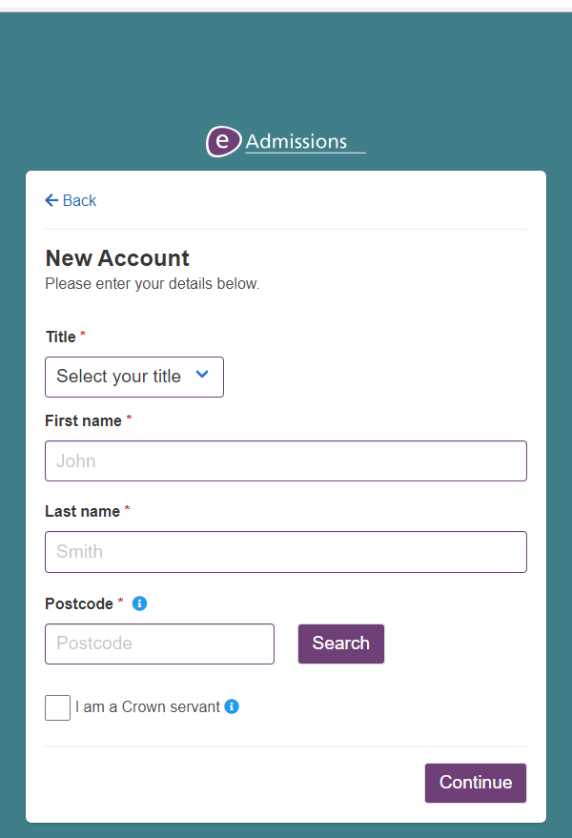

Slide 11
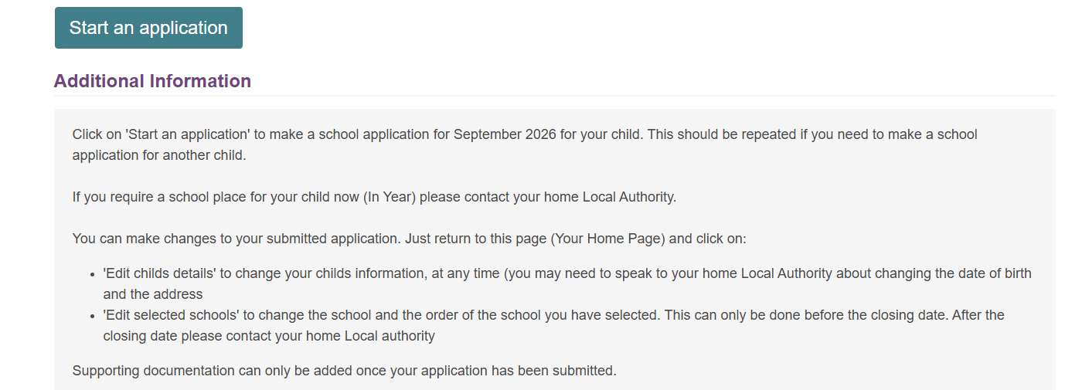
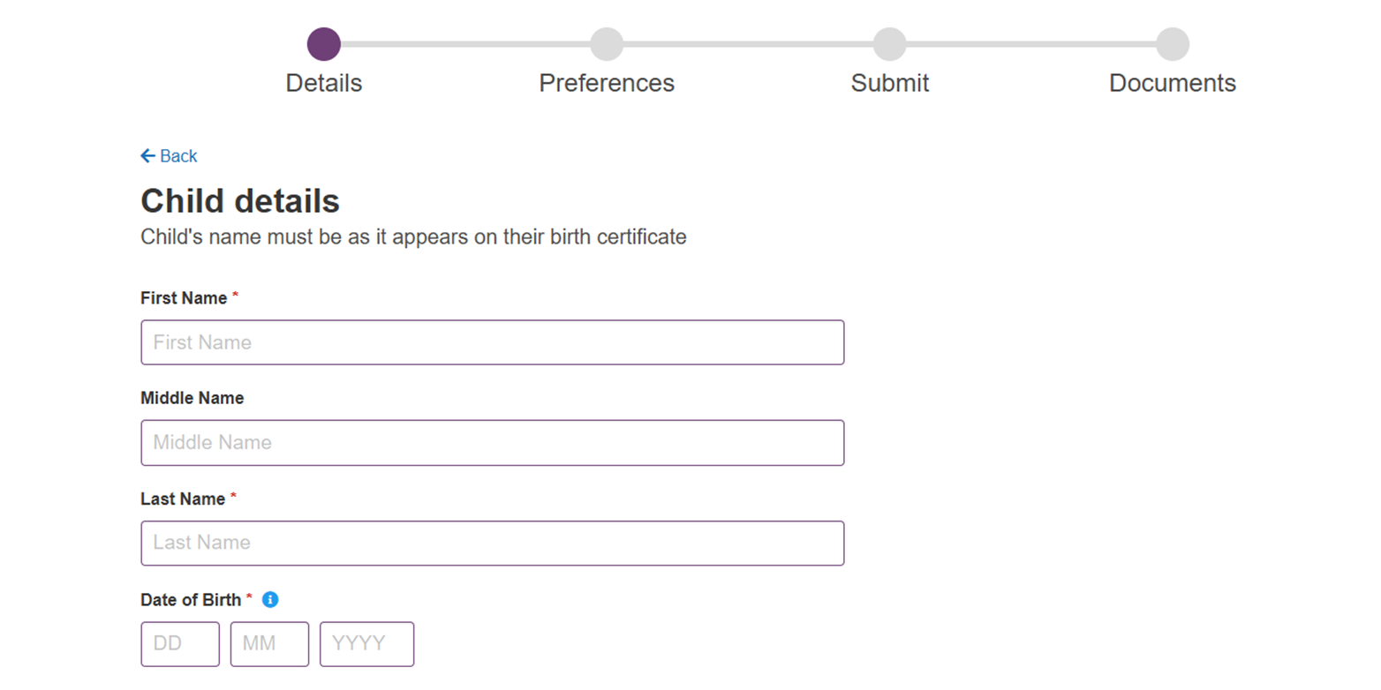

Slide 12

When to apply
Application opens: 1 September 2025 via the eAdmissions portal.
Deadline: 31 October 2025
https://services.southwark.gov.uk/schools-and-education/school-admissions/secondary-admissions/applying-for-a-secondary-school-place
School offers released: 1 March 2026 for on-time applicants.

Slide 13
Southwark
If your child has a sibling (brother or sister), at one of your preferential schools, please ensure that you tick the sibling box.
Once you have completed your online application, take note that you receive your 16 digit application reference number starting with 210 similar to this: 210-2018-09-E-002100.
If you do not receive a unique reference number it means your application has not been received and you will need to resubmit your application.
Keep a record of your unique user name, password and application number which you will use for your application. It is important to keep this information safe so that you can log in and look at your application and review the results.

Slide 14
Ability/Aptitude tests
Kingsdale Foundation School (aptitude places)
The City of London Academy (Southwark) (aptitude places)
St Saviour’s & St Olave’s School (ability places)
For more information, contact the schools directly.

Slide 15
Some schools will ask you to complete a SIF (Supplementary Information Form)
To collect information that is not on the application form
Information used against published admissions criteria (e.g. a faith school may require evidence of church attendance)
Check school brochure to find out if SIF is required
Fill out both forms by the correct date and send to the correct place

Slide 16
After the closing date
Each school named considered
Applications to schools outside of Southwark sent electronically to relevant borough
Oversubscription criteria applied if oversubscribed
If more than one of preferred schools can offer place – highest ranked school chosen
One offer of one school place is made only
If no offer made from preferred schools, Southwark will allocate
Offers are conditional until proof of address is provided
The Southwark Council admissions team holds waiting lists for all Southwark schools until 10 July 2025. After that From 11 July 2025 onward, each individual school takes over responsibility for its own waiting list

Slide 17
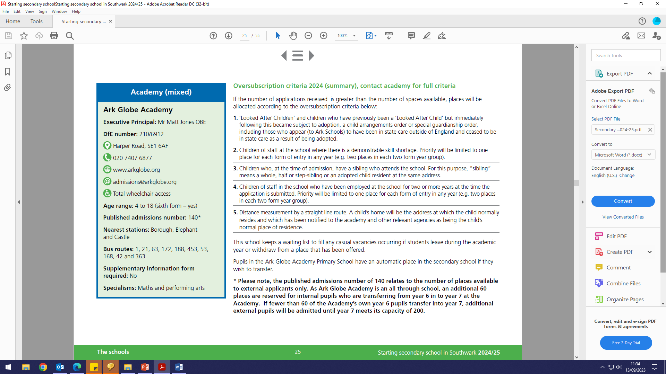

Slide 18
Offer day
Monday 2nd March 2025 – (after 5pm via email - no action required if you wish to accept the place)
Applicants can also view the outcome of their application during the evening at www.eadmissions.org.uk

Slide 19
Rejecting an offer
Should you wish to reject the offer of a school place allocated to your child, you must notify the school admissions team by email at schools.admissions@southwark.gov.uk and include your unique application reference.
Appeals: Check dates of appeal hearings with individual schools. For further information about the appeals process contact Southwark Council’s school admissions team on 020 7525 5337 or by obtaining a copy of the School Admissions Appeals Code from the Department for Education (DfE), contact details on page 48 of the brochure.

Slide 20
Southwark Admissions
School admissions team 4th floor,
Hub 2 Children’s and adults services Southwark Council
PO Box 64529
London SE1P 5LX
www.southwark.gov.uk/schooladmissions
Email: schools.admissions@southwark.gov.uk
Phone: 020 7525 5337

