Slide 1
Years 3 and 4 Reading Workshop

Slide 2


Slide 3
“English is a hugely important subject and reading is the gateway to wider learning. The focus being given to the teaching of phonics means more children are leaving primary school able to read.” (Sir Martyn Oliver, Chief Inspector)
“Reading is the gateway to learning. Pupils who struggle with the basic mechanics can quickly fall behind.” (Ofsted’s guiding principle, in Getting all pupils reading)

Slide 4
Reading matters
Becoming a fluent, skilled and attentive reader starts at the earliest stages, before children encounter a book for the first time.
Often driven by factors such as,
Quality of parents talk and engagement in conversations
Talk about books, stories and rhymes
Vocabulary children are exposed to.
We, together can begin to close this gap!
Notes:
The only effective route to closing this gap is for children to be taught systematically to read as soon as they start school. In this way, they do not have to rely on adults.
Engage and motivate children
Tools to read by themselves
they learn how stories start and finish, and how a plot unravels and is resolved; which feeds into their writing
Parents who engage their children in books prepare them to became committed and enthusiastic readers
Disadvantaged families hear less words, phonics is a way of teaching children to read and closing the gap.

Slide 5
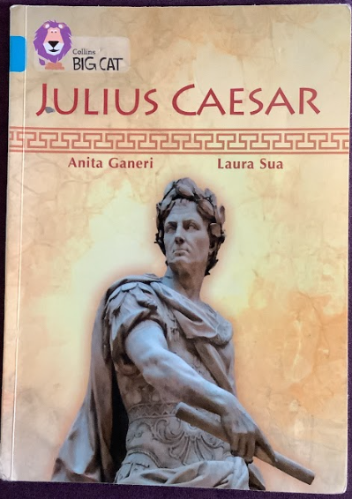
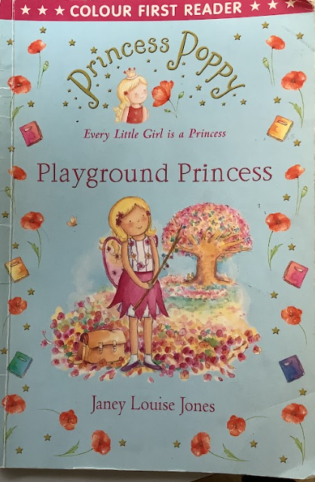
Reading Books at Their Level
Children may have the following books in their book bags:
Little Wandle Letters and Sounds decodable reader
Big Cat Collins coloured banded book
Free choice chapter book
Library book

Slide 6
Daily Reading Expectation
Children should read at least 10 minutes per day
Benefits include:
Improved brain connectivity
Increased vocabulary & comprehension
Better empathy & understanding
Support with sleep readiness

Slide 7
Reading for Pleasure
Encourage lifelong reading habits
Sharing books at home:
• Discuss pictures & predict what happens next
• Use character voices & explore non-fiction facts
• Most important: Have fun together!

Slide 8
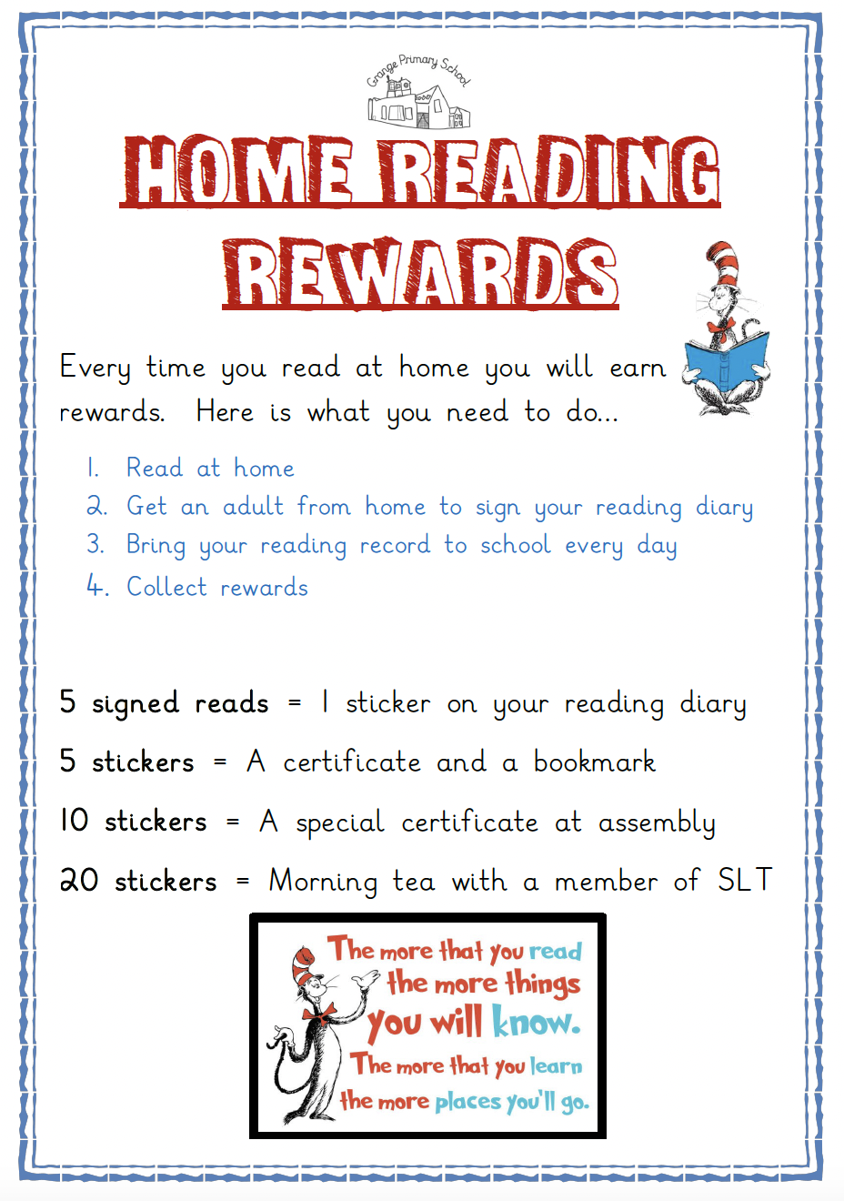

Slide 9
Benefits of Reading Together
Stimulates imagination & curiosity
Expands vocabulary, language & listening
Improves memory, thinking & reasoning
Builds confidence, security & self-esteem
Provides comfort, fun & relaxation
Shows your child they matter

Slide 10


Slide 11
How is reading taught at Grange in Years 3 and 4?
We have three taught whole class reading sessions per week where the class text is read and learning completed around it.
We have one session which we call the ‘book talk’ session where the children discuss the books they are reading in a structured way with their peers and adults as well as being exposed to new books, genres, etc
We also have a library session where the children visit the school library and borrow books to support their reading for pleasure.

Slide 12
What are the national curriculum expectations for Years 3 and 4?
The reading curriculum is divided into two complementary strands:
1. Word reading (decoding)
2. Comprehension (listening to / reading and understanding)
By Years 3 and 4, the emphasis shifts increasingly toward comprehension and understanding of more complex texts, while continuing to consolidate decoding skills.
If any pupil has not yet developed sufficient phonics / decoding skills in earlier years, schools are instructed to continue using the Year 1 word-reading programme as support, while applying the Year 2 comprehension expectations.

Slide 13
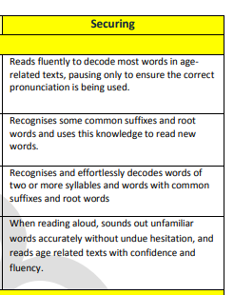
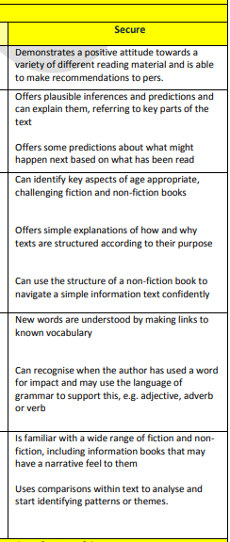
On track by the end of the year 3?
Here are the key objectives they will roughly have to meet in order to be at expected levels for their age
Word reading Comprehension

Slide 14
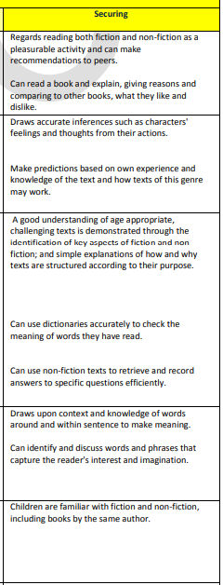
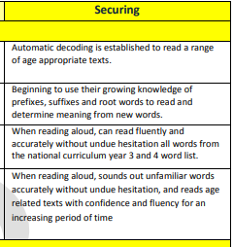
On track by the end of the year 4?
Here are the key objectives they will roughly have to meet in order to be at expected levels for their age
Word reading Comprehension

