Slide 1

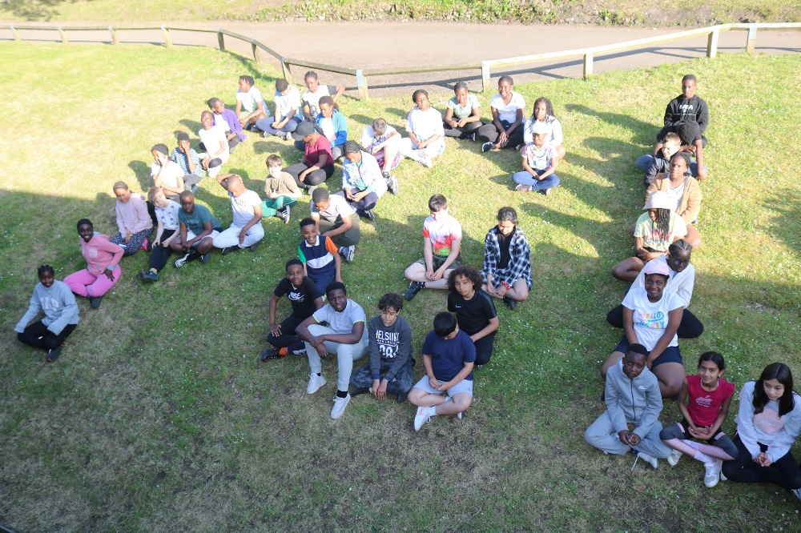
Year 6 PGL
Presentation
2026

Slide 2

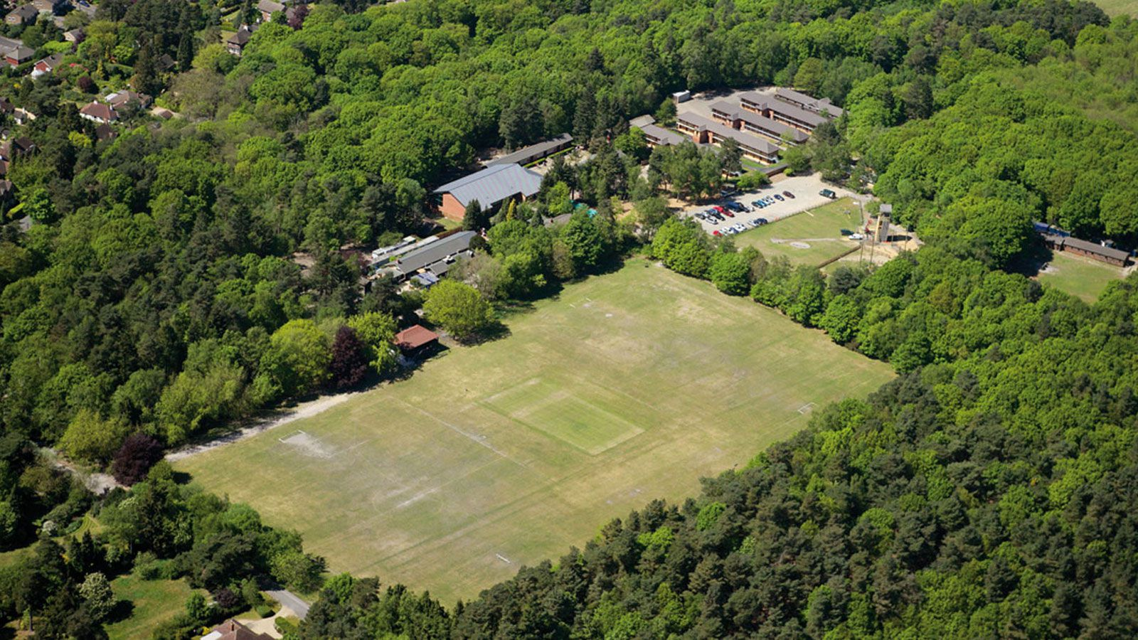
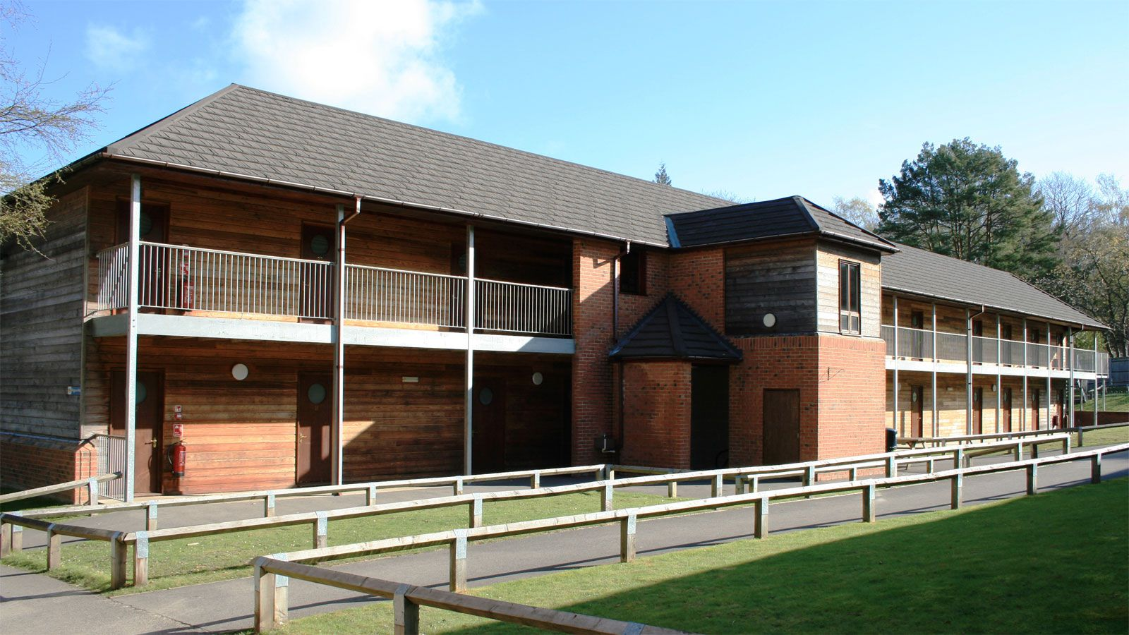
Accommodation
Setting

Slide 3

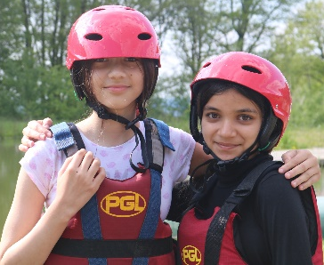
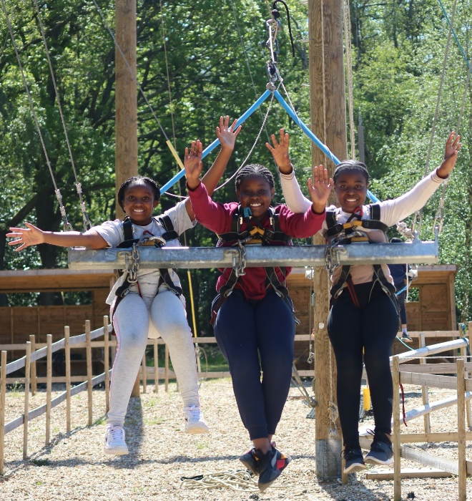
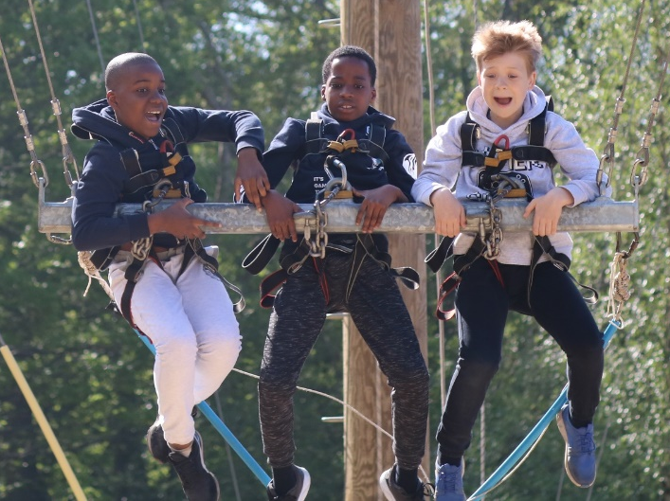


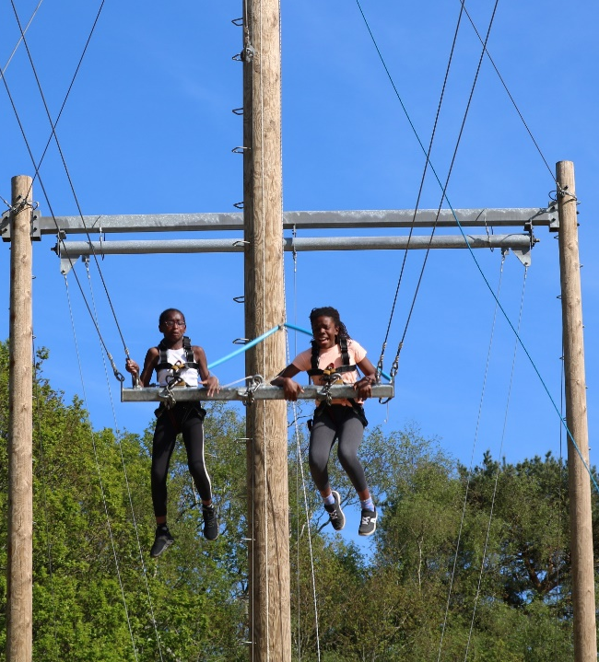
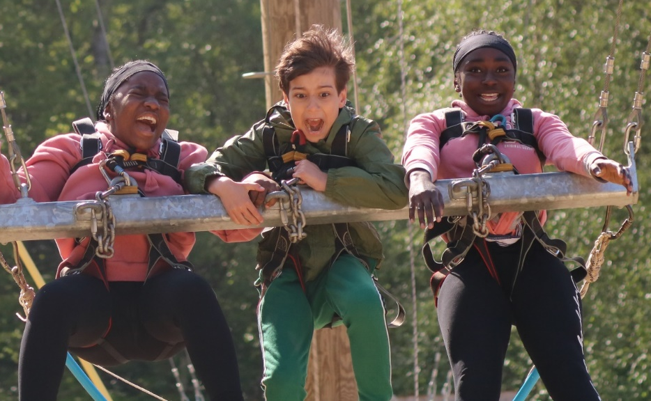
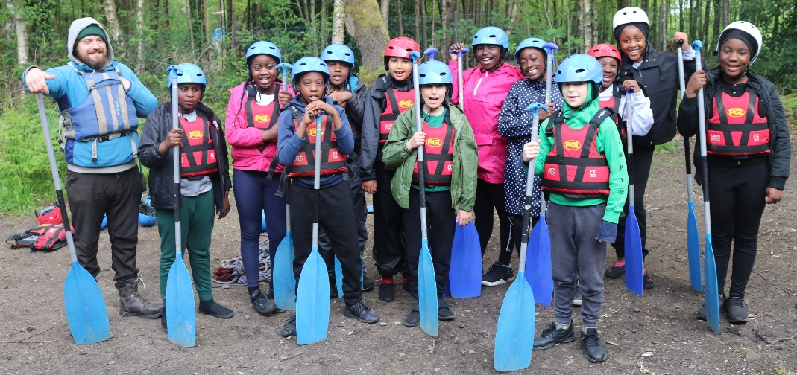
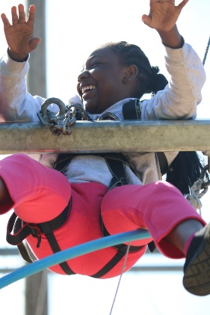
Giant Swing
Raft Building

Slide 4
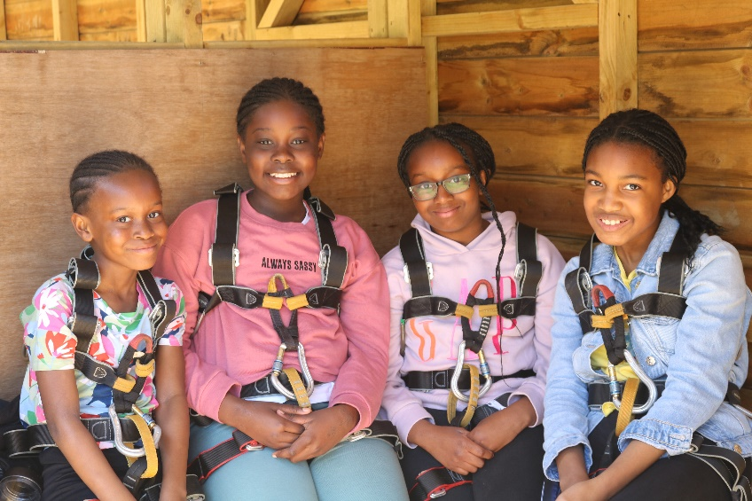
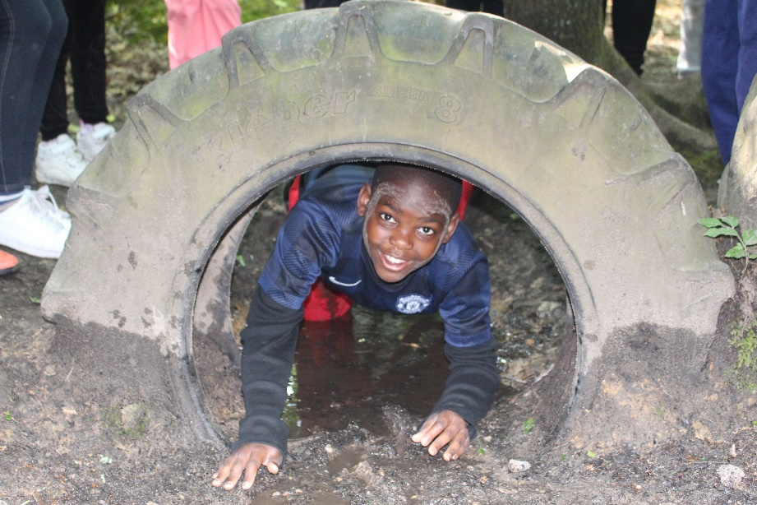
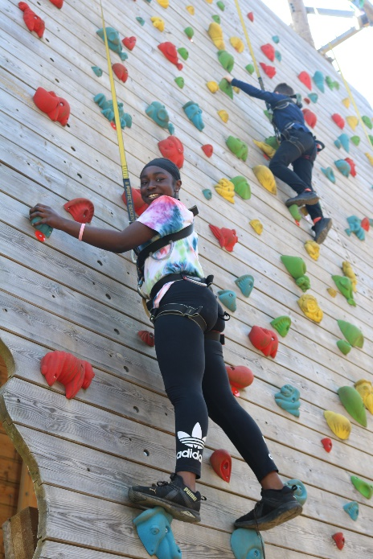
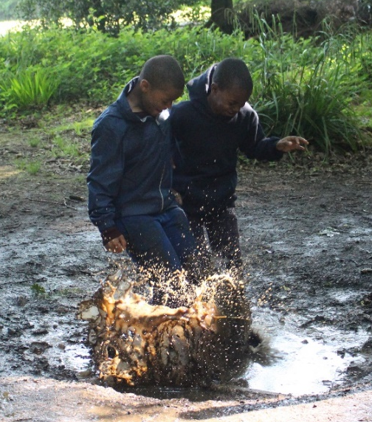
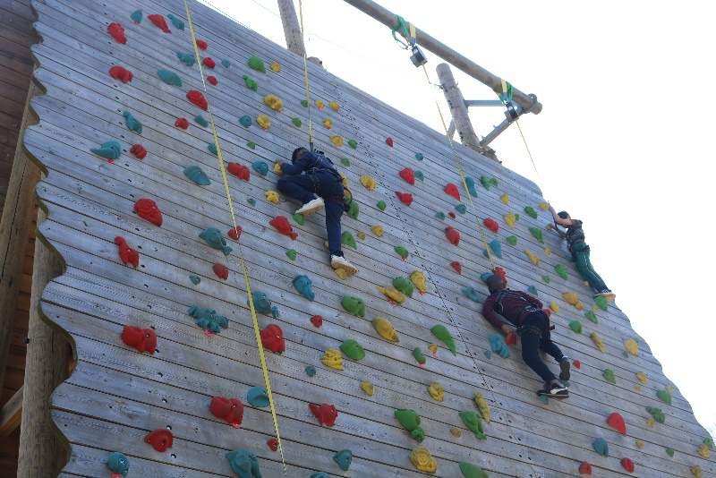
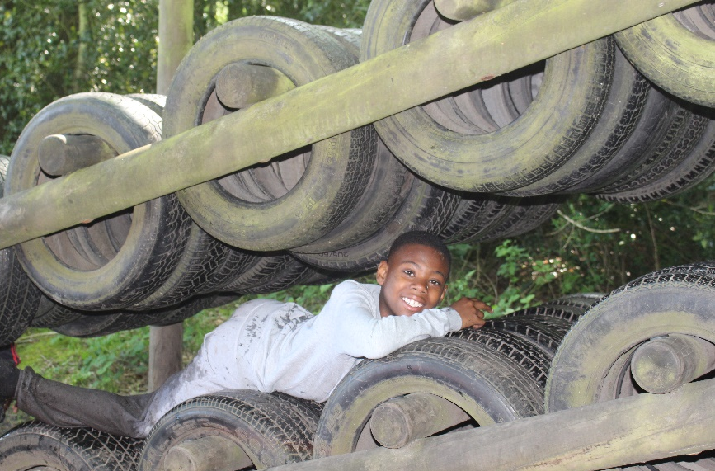
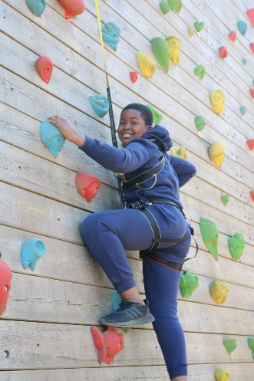
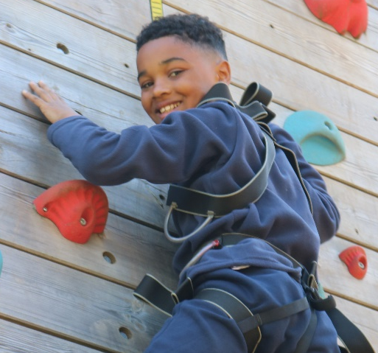
Challenge Course
Climbing Wall

Slide 5
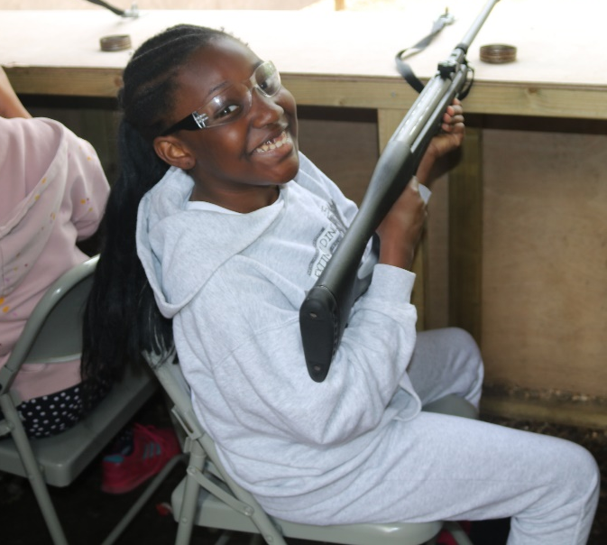
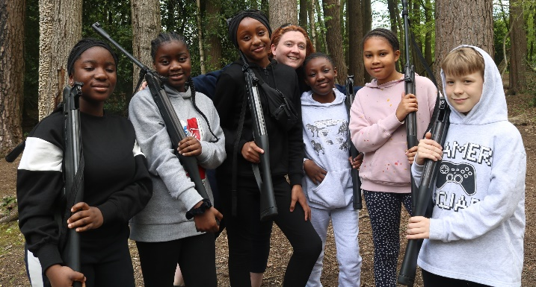
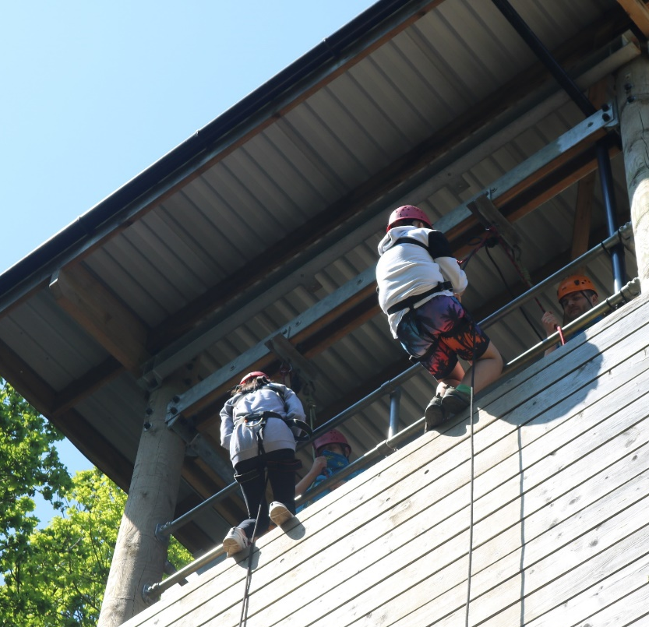
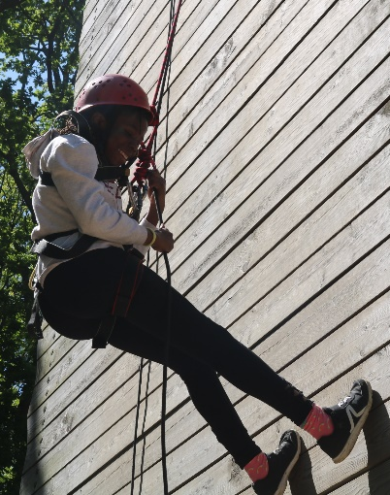
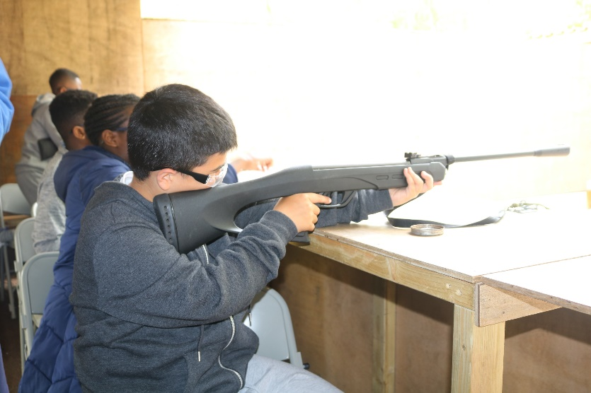
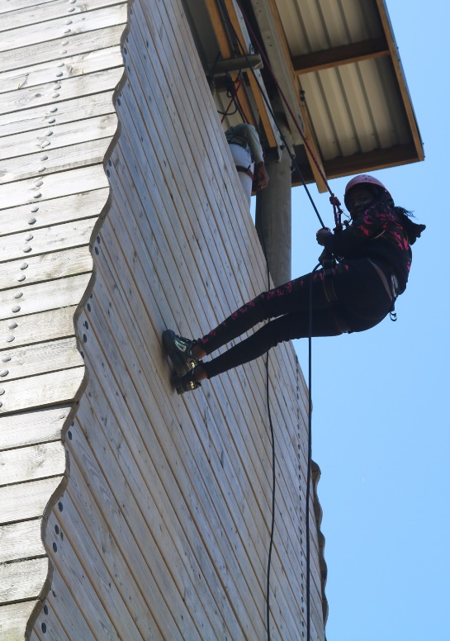
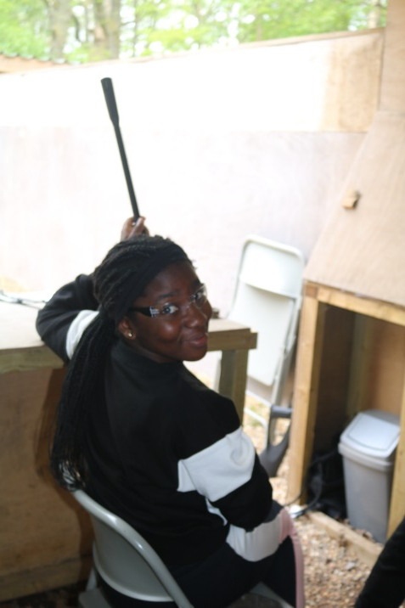
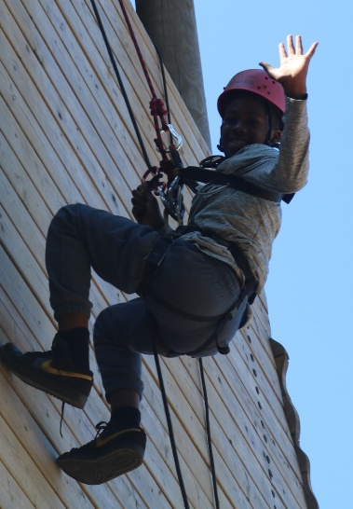
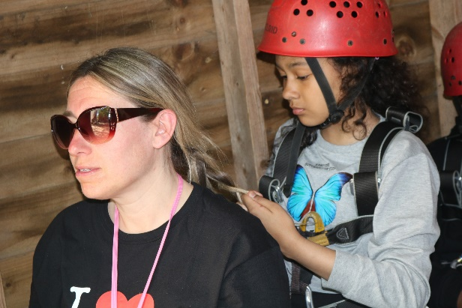
Abseiling
Rifles

Slide 6
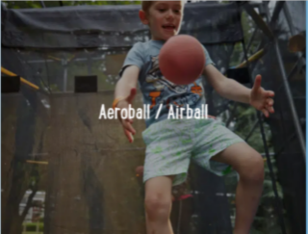
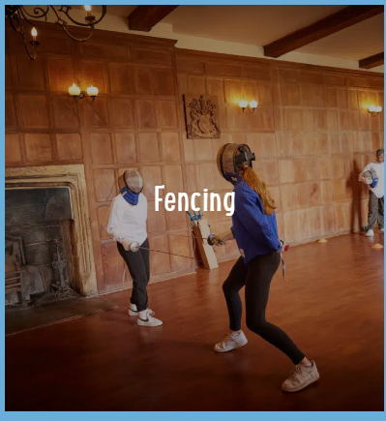
Balloon Splash

Slide 7

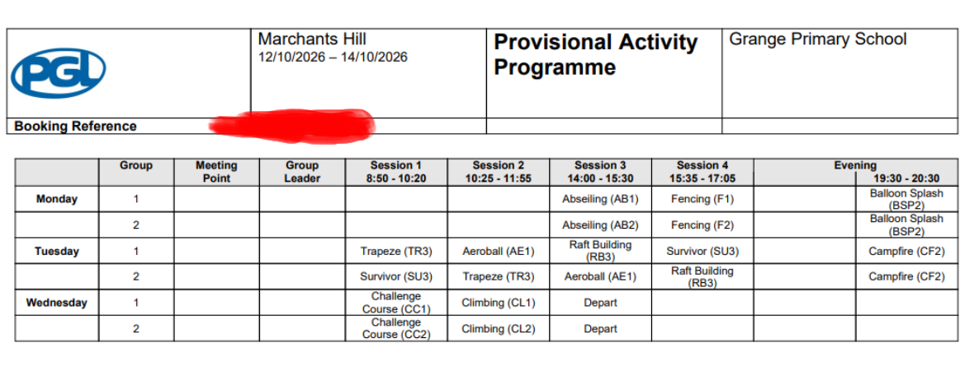
Itinerary

Slide 8
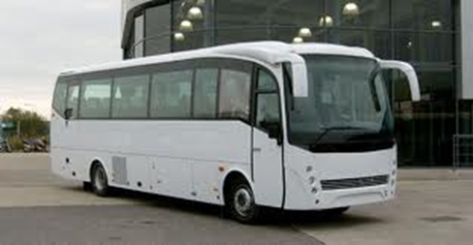
All Children to arrive at school with their holiday belongings. You are welcome to wait until the coach departs, so that you can get a final hug and wave them off.
12th October
Pick up 10:30 from Grange Primary School to PGL Centre GU26 6RF
14th October
Pick up 1:45 from PGL Centre GU26 6RF to Grange Primary School (arrive 4 (approx.)

Slide 9
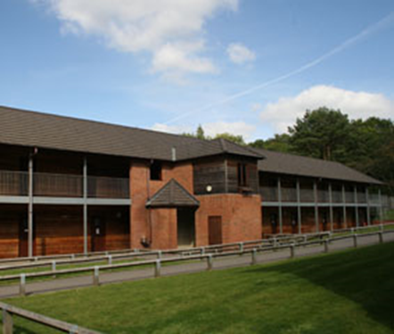
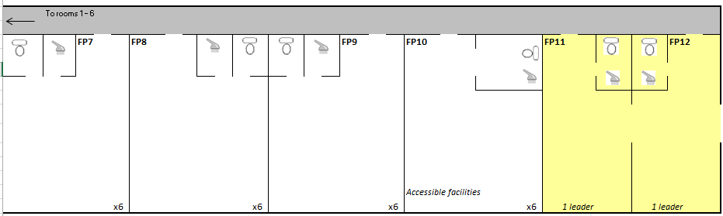
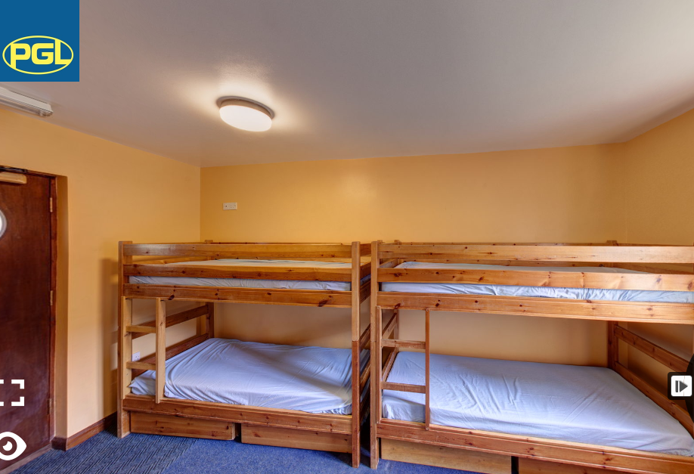
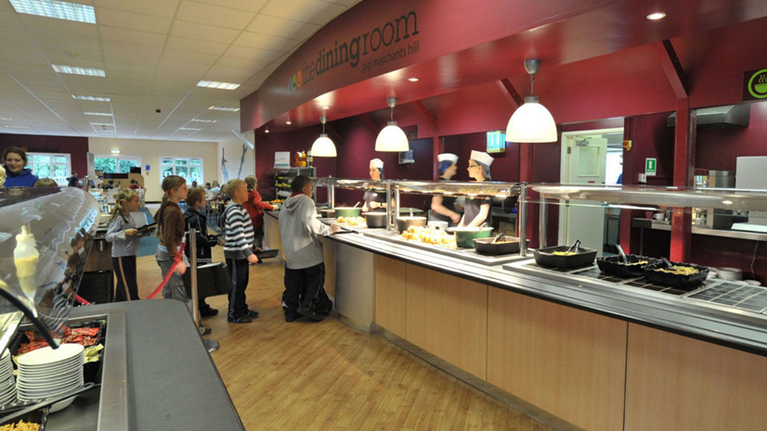
Pupils: En suite rooms sleeping 4/5 per room.
Adults: En suite single/twin room at the edge / middle of children’s accommodation
The Dining Room offer a variety of main courses and side options, like soup, bread and salad. Water and juice is also available at every meal.
A menu board at the entrance advises children about food content and gives allergy information. The children must make sensible selections if they have any allergy concerns. Please complete the allergy part on the medical form.

Slide 10
Behaviour expectations:
The behaviour expectations are the same as expected in school.
Your child must listen and comply with all instructions first time.
They must be respectful to all the Grange and PGL staff.
They should be kind and considerate to the other children on the trip.
They must not engage in any silly or dangerous behaviour.
They should wear suitable clothing for the activity.
They should allow others in their room to sleep uninterrupted.
If your child does not adhere to one or more of these, possible consequences are:
Missing an activity
Missing out on free time
Group or room change
Not being able to chose where to sit during meal times
Standing/sitting outside their room.
Not being allowed in the shop
In extreme circumstances, being sent home.
Consequences:

Slide 11


Slide 12
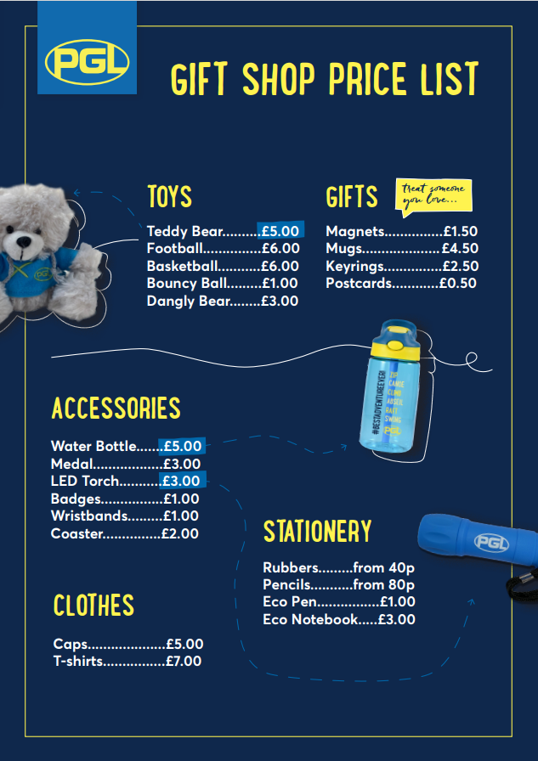
Children can bring money. But no more than £10.
We will not be collecting money in.
It will be your child’s responsibility.

Slide 13
What to Bring…
🎒 PGL Residential Trip – Packing List for 3 Days
👕 Clothing
3 x t-shirts or tops
3 x pairs of trousers/leggings/joggers (not jeans – they don’t dry easily)
3 x sets of underwear and socks
1 x warm jumper or hoodie
1 x waterproof jacket or coat
1 x pair of old trainers (for outdoor activities – they may get muddy/wet!)
1 x pair of clean trainers/shoes (for indoors)
1 x set of pyjamas
1 x hat/cap (for sun protection) or warm hat/gloves (if cold weather)
🛁 Toiletries
Toothbrush & toothpaste
Hairbrush/comb
Soap/shower gel
Shampoo & conditioner
Deodorant (roll-on preferred – no sprays)
Towel for showering
Small towel or flannel (optional)
🛏️ Bedding
  Sleeping bag or duvet.
  Pillow and pillowcase.
👜 Other Essentials
Reusable water bottle.
Small backpack/day bag.
Plastic bag/bin liner (for dirty clothes)
Book, notebook, or quiet activity for free time
Hair ties (for long hair – needed for activities)
🚫 Do Not Bring
Mobile phones or electronics
Expensive items or jewellery
Aerosol sprays – pack roll on deodorant .

Slide 14
Frequently asked questions
.
Can my child bring their mobile phone?
No – All mobile phones must be left at home. If a child is found in possession of their mobile phone, it will be confiscated.
Can my child bring their electronic device / digital camera?
No electronic devices, other than a digital camera are allowed. The camera must be labelled and your son/daughter is responsible for looking after it .
Will they get enough food to eat?
There is plenty of hot and cold choices in the dining hall.
Which members of staff are going with the group?
Mr Bucknall and Ms Matheson
Are there first aiders on site?
All instructors are trained in first aid and there are first aiders available at all times. Mr Bucknall is also first aid trained.
My child has medication – what do I need to do next?
All medication must be placed in the correct box, which contains the prescription information on it. It must be in date and should be labelled clearly with your child’s name on both the box and bottle/tablets.
Can my child bring money with them?
Yes, your child can bring up to £10.00
What if my child becomes homesick?
The staff on the trip are extremely experienced and will deal with all incidents of homesickness with compassion.

